Slide 1
CAREER EXCELLENCE COMMUNITY
EXCEL YOUR CAREER WITH NETWORKING
Designed & Developed By: Aryan Agrawal Vikas Prajapati
Akarsh Srivastava Shobhit Singh

Slide 2
Contents
Agenda
Title
Technologies Used
How Different?
Members Contribution
Final Layout

Slide 3

Agenda
Did you know the importance of Networking in our career?
Networking and connections help us to explore the different fields out of range.
Networking provides high chances of growth in career and references to others.
Networking opens new possibilities of career development and earnings.
Every successful person have good networks and high connections.

Slide 4
CAREER EXCELLENCE COMMUNITY
EXCEL YOUR CAREER WITH NETWORKING

Slide 5




Technology Used
Creating the website using HTML, CSS, JavaScript, and PHP.
We use the SQL for the database creation.
We also bootstrapped some parts of the website from LinkedIn Website
We used the 000web-hostinger to host our website over the internet.

Slide 6


Platform Discussion
The full platform of the Career Excellence Community is designed very simply and user-friendly so that everyone loves to share and post their content.
The platform also helps students ( freshers, graduates, or anyone) or experienced people join the community of like-minded hustlers.
Exploring the platform will surely be interesting and reacting to others’ posts also easy.
Everyone connects and messages with each other easily and effectively in a secure environment.

Slide 7

28
Layout

Slide 8
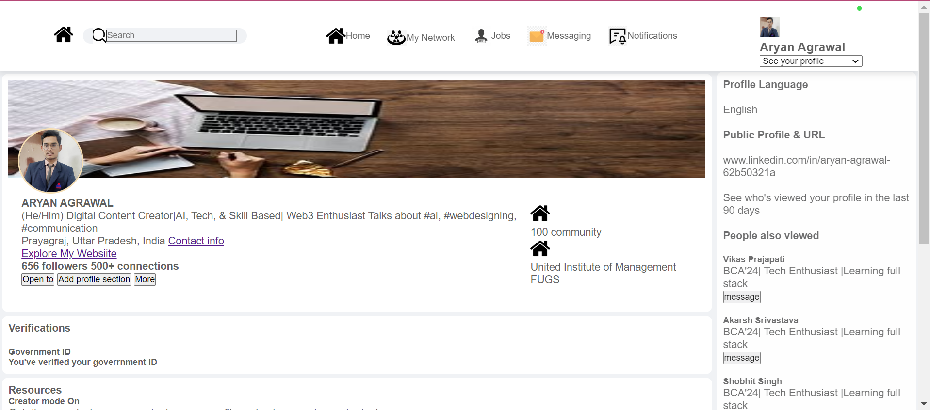
User Dashboard

Slide 9

User Dashboard
Designed by Aryan Agrawal
After successful registration, the user dashboard page is created for every users who joined our Career Excellence Community.
In this page all the career and academic related information are saved and shown to other users who view their profiles.
The profile information will update by users according to their career achievements.
This user page is designed using the HTML, CSS, JS.
Using the reference of LinkedIn user page, this user page is designed.

